Slide 1


Programming Project 03
Christine Robinson, Francèl Lamprecht, Regina Wehler

Slide 2
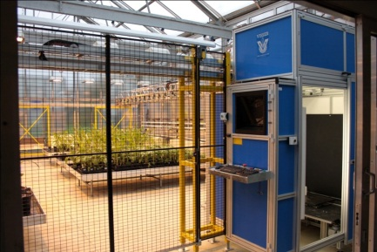
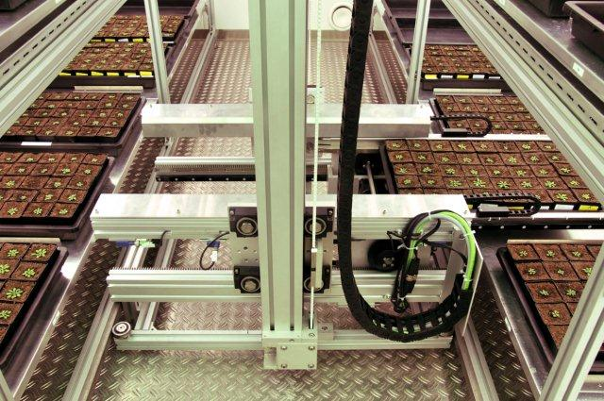
Plant Phenotyping
main bottleneck in plant research and breeding is the phenotyping capability
required: high-throughput phenotyping with non-invasive methods to screen root and shoot phenotypes
solution: robotic driven greenhouses
examples at the Forschungszentrum Jülich:
both greenhouses are equipped with robots that transport plants to imaging stations
SCREEN House
GROWSCREEN chamber

Slide 3
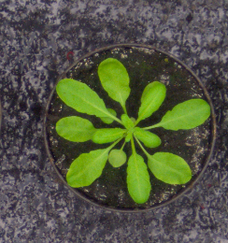
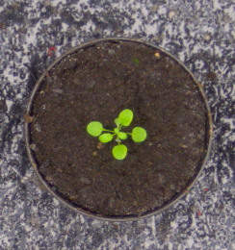
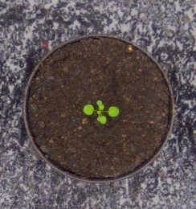
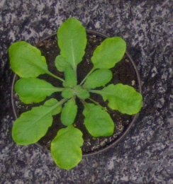
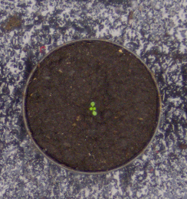
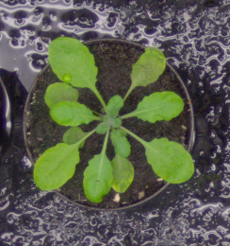
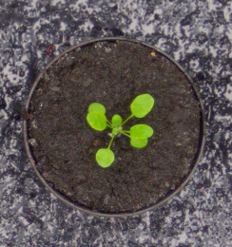
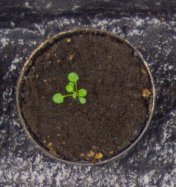
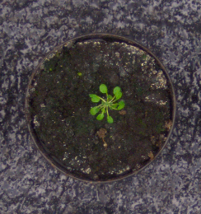
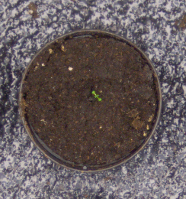
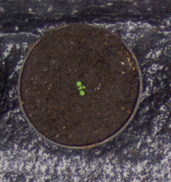
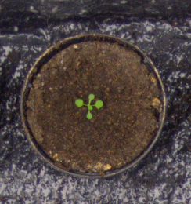
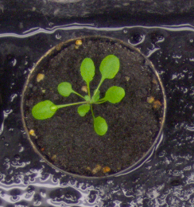
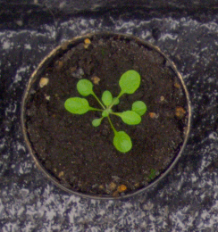
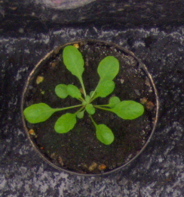
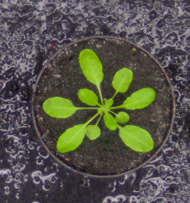
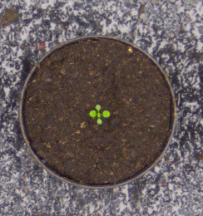
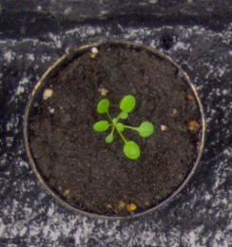
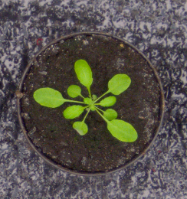
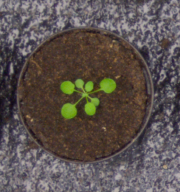
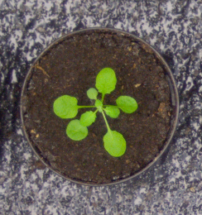
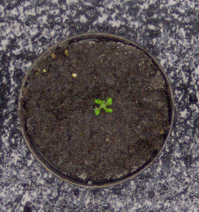
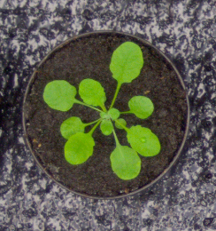
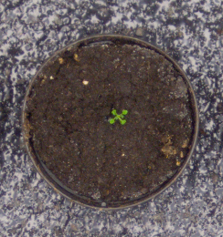
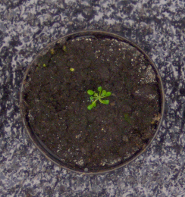
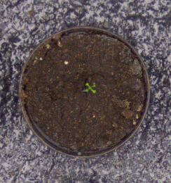
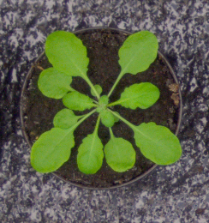
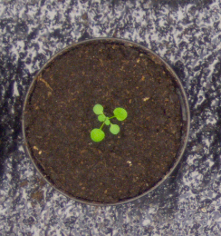
Computer Science Part
➔ Automated analysis of automatically acquired plant images

Slide 4


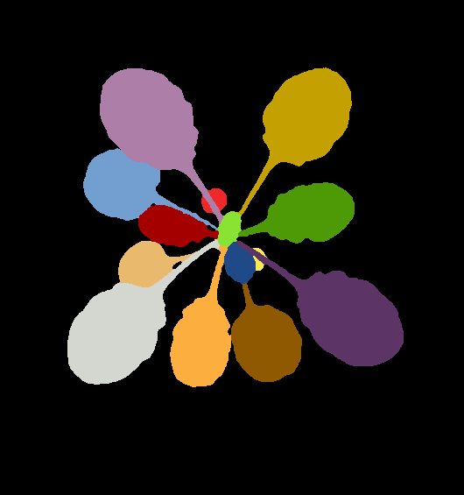
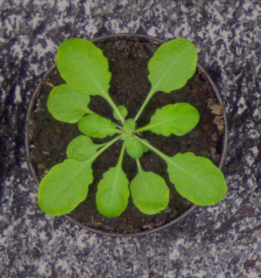
Goal of this Project
develop a simple approach for plant classification of top view photos of seedlings
Two main parts:
Image Analysis with Fiji in Java
Explorative Data Analysis with Python in Jupyter Notebooks
Data Sets: training sets from the Leaf Segmentation and Counting Challenges of the International Plant Phenotyping Network which include wild type and mutant plants

Slide 5



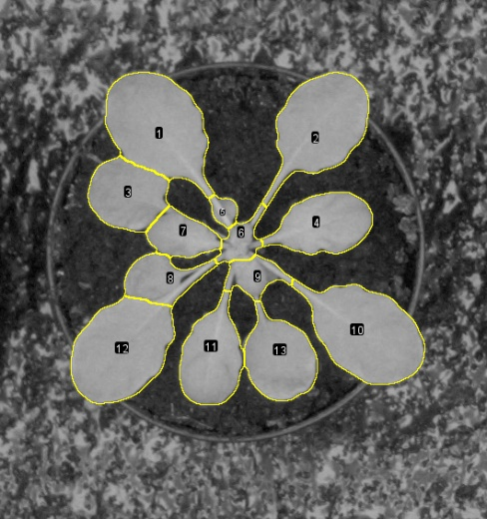
Image Analysis Pipeline
1.) RGB input image
2.) Classification
3.) Leaf Identification
4.) Leaf Analysis

Slide 6
Image Analysis Pipeline
Trainable Weka
Segmentation
1.) RGB input image
2.) Classification
3.) Leaf Identification
4.) Leaf Analysis

Slide 7
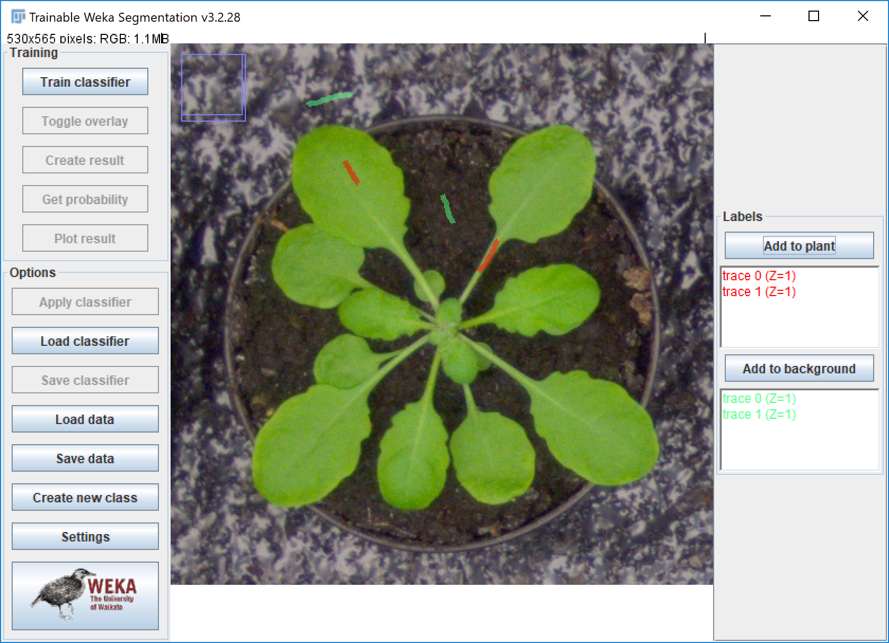
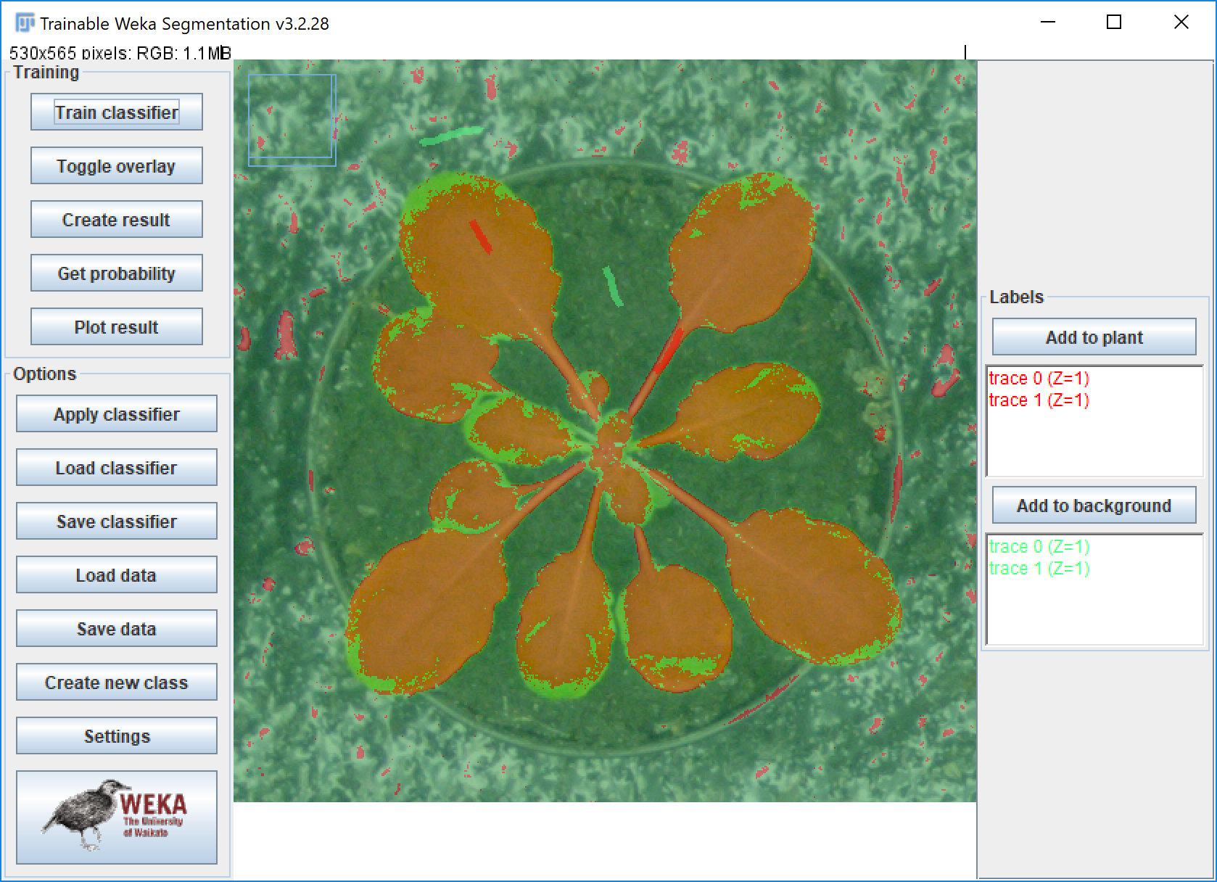
Trainable Weka Segmentation
training a FastRandomForest classifier in the Weka GUI
using 6 diverse photos

Slide 8
Image Analysis Pipeline
Single Leaf
Segmentation
1.) RGB input image
2.) Classification
3.) Leaf Identification
4.) Leaf Analysis

Slide 9

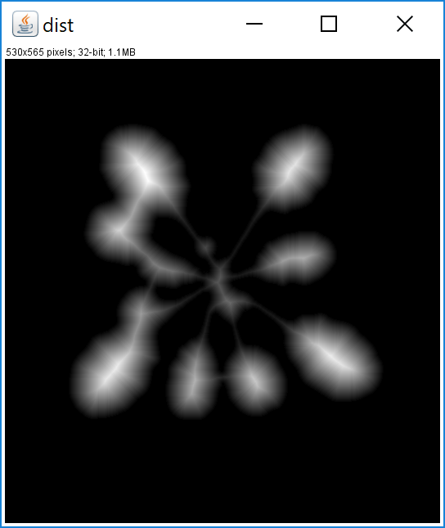
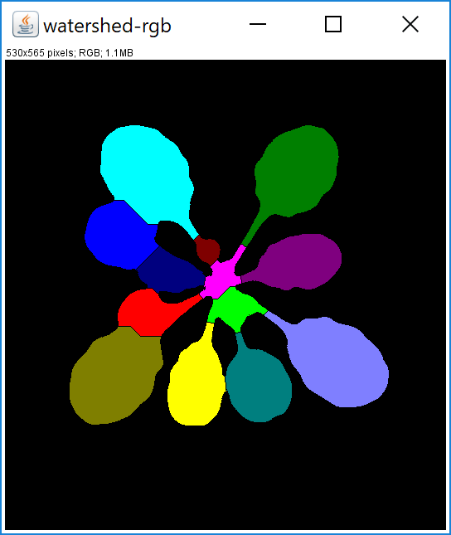
Watershed Segmentation
1
2
input: binary class image
step 1: compute distance map, i.e. compute for each white pixel the chamfer distance to the nearest background (black) pixel
step 2: draw a line (= separate two objects) where two „watersheds“ meet
output: binary image with added watershed lines
Notes:
* Computes the distance map from a binary image processor, by specifying * weights and normalization. * Distance is computed for each foreground (white) pixel, as the chamfer * distance to the nearest background (black) pixel.

Slide 10
Image Analysis Pipeline
1.) RGB input image
2.) Classification
Particle
Analyzer
3.) Leaf Identification
4.) Leaf Analysis

Slide 11
Particle Analyzer

Slide 12
Data Analysis

Slide 13
Summary

Slide 14
Thank you for your attention!
Questions?

